Slide 1
Software Engineering
Sara Rehmat
MS (CS)

Slide 2
Product Metrics

Slide 3
Metrics in daily life
Metrics is a system or standard of measurement.
Metrics in daily life
Living
Cost of utilities for the month
Cost of groceries for the month
Amount of monthly rent per month
College experience
Grades received in class last semester
Number of classes taken each semester
Amount of time spent in class this week
Amount of time spent on studying and homework this week
Number of hours of sleep last night
Travel
Time to drive from home to the airport
Amount of miles traveled today
Cost of meals and lodging for yesterday

Slide 4
Why Software Metrics?
Help software engineers to better understand the attributes of models and assess the quality of the software
Help software engineers to gain insight into the design and construction of the software
Focus on specific attributes of software engineering work products resulting from analysis, design, coding, and testing
Provide a systematic way to assess quality based on a set of clearly defined rules
Provide an “on-the-spot” rather than “after-the-fact” insight into the software development

Slide 5
Process, Project and Product
A software process specifies the abstract set of activities that should be performed to go from user needs to final product. The actual act of executing the activities for some specific user needs is a software project. And all the outputs that are produced while the activities are being executed are the products.

Slide 6
Product Metrics
Software Quality
A framework for Metrics
Metrics for the analysis model
Metrics for the design model
Metrics for the source code
Metrics for maintenance

Slide 7
Software Quality

Slide 8
Software Quality
Definition:
“Conformance to explicitly stated functional and performance requirements, explicitly documented development standards, and implicit characteristics that are expected of all professionally developed software.”

Slide 9
Software Quality
Explicit software requirements are the foundation from which quality is measured. Lack of conformance to requirements is lack of quality.
Specific standards define a set of development criteria that guide the manner in which software is engineered. If the criteria are not followed, lack of quality will most surely result
There is a set of implicit requirements that often goes unmentioned (e.g., ease of use). If software conforms to its explicit requirements but fails to meet implicit requirements, software quality is suspect

Slide 10
Properties of Software Quality Factors
Some factors can be directly measured (e.g. defects uncovered during testing)
Other factors can be measured only indirectly (e.g., usability or maintainability)
Software quality factors can focus on three important aspects
Product operation: Its operational characteristics
Product revision: Its ability to undergo change
Product transition: Its adaptability to new environments

Slide 11
ISO 9126 Software Quality Factors
Functionality
The degree to which the software satisfies stated needs
Reliability
The amount of time that the software is available for use
Usability
The degree to which the software is easy to use
Efficiency
The degree to which the software makes optimal use of system resources
Maintainability
The ease with which repair and enhancement may be made to the software
Portability
The ease with which the software can be transposed from one environment to another

Slide 12
Framework for Metrics

Slide 13
Measures, Metrics, and Indicators
These three terms are often used interchangeably, but they can have subtle differences
Measure
Provides a quantitative indication of the extent, amount, dimension, capacity, or size of some attribute of a product or process
Measurement
The act of determining a measure
Metric
(IEEE) A quantitative measure of the degree to which a system, component, or process possesses a given attribute.
Indicator
A metric or combination of metrics that provides insight into the software process, a software project, or the product itself

Slide 14
Purpose of Product Metrics
Aid in the evaluation of analysis and design models
Provide an indication of the complexity of procedural designs and source code
Facilitate the design of more effective testing techniques
Assess the stability of a fielded software product

Slide 15
Activities of a Measurement Process
Formulation
The derivation (i.e., identification) of software measures and metrics appropriate for the representation of the software that is being considered.
Collection
The mechanism used to accumulate data required to derive the formulated metrics.
Analysis
The computation of metrics and the application of mathematical tools.
Interpretation
The evaluation of metrics in an effort to gain insight into the quality of the representation
Feedback
Recommendations derived from the interpretation of product metrics and
passed on to the software development team

Slide 16
Characterizing and Validating Metrics
A metric should have desirable mathematical properties.
It should have a meaningful range (e.g., zero to ten)
It should not be set on a rational scale if it is composed of components measured on an ordinal scale
If a metric represents a software characteristic that increases when positive traits occur or decreases when undesirable traits are encountered, the value of the metric should increase or decrease in the same manner
Each metric should be validated empirically in a wide variety of contexts before being published or used to make decisions.
It should measure the factor of interest independently of other factors
It should scale up to large systems
It should work in a variety of programming languages and system domains

Slide 17
Goal-oriented Software Measurement
Goal/Question/Metric (GQM) paradigm has been developed by Basili and Weiss as a technique for identifying meaningful metrics for any part of the software
GQM technique identifies meaningful metrics for any part of the software process.
GQM emphasizes the need to
Establish an explicit measurement goal that is specific to the process activity or product characteristic that is to be assessed
Define a set of questions that must be answered in order to achieve the goal
Identify well-formulated metrics that help to answer these questions
GQM utilizes a goal definition template to define each measurement goal.

Slide 18
Goal-oriented Software Measurement
Example use of goal definition template
Analyze the SafeHome software architecture for the purpose of evaluating architecture components. Do this with respect to the ability to make SafeHome more extensible from the viewpoint of the software engineers, who are performing the work in the context of product enhancement over the next three years.
Example questions for this goal definition
1) Are architectural components characterized in a manner that compartmentalizes function and related data?
2) Is the complexity of each component within bounds that will facilitate modification and extension?

Slide 19
Attributes of Effective Software Metrics
Simple and computable
It should be relatively easy to learn how to derive the metric, and its computation should not demand inordinate effort or time
Empirically and intuitively persuasive
The metric should satisfy the engineer’s intuitive notions about the product attribute under consideration
Consistent and objective
The metric should always yield results that are unambiguous

Slide 20
Attributes of Effective Software Metrics
Consistent in the use of units and dimensions
The mathematical computation of the metric should use measures that do not lead to bizarre combinations of units
Programming language independent
Metrics should be based on the analysis model, the design model, or the structure of the program itself
An effective mechanism for high-quality feedback
The metric should lead to a higher-quality end product

Slide 21
Metrics for the Analysis Model
Functionality delivered
Provides an indirect measure of the functionality that is packaged within the software
System size
Measures the overall size of the system defined in terms of information available as part of the analysis model
Specification quality
Provides an indication of the specificity and completeness of a requirements specification

Slide 22
1. Function Points
Introduction to Function Points
First proposed by Albrecht in 1979; hundreds of books and papers have been written on functions points since then
Can be used effectively as a means for measuring the functionality delivered by a system
Using historical data, function points can be used to
Estimate the cost or effort required to design, code, and test the software
Predict the number of errors that will be encountered during testing
Forecast the number of components and/or the number of projected source code lines in the implemented system
Derived using an empirical relationship based on
1) Countable (direct) measures of the software’s information domain
2) Assessments of the software’s complexity

Slide 23
Information Domain Values
Number of external inputs
Each external input originates from a user or is transmitted from another application
They provide distinct application-oriented data or control information
They are often used to update internal logical files
They are not inquiries (those are counted under another category)
Number of external outputs
Each external output is derived within the application and provides information to the user.
This refers to reports, screens, error messages, etc.
Individual data items within a report or screen are not counted separately

Slide 24
Information Domain Values
Number of external inquiries
An external inquiry is defined as an online input that results in the generation of some immediate software response.
The response is in the form of an on-line output.
Number of internal logical files
Each internal logical file is a logical grouping of data that resides within the application’s boundary and is maintained via external inputs
Number of external interface files
Each external interface file is a logical grouping of data that resides external to the application but provides data that may be of use to the application

Slide 25
Function Point Computation
Identify/collect the information domain values
Complete the table shown on next slide to get the count total
Associate a weighting factor (i.e., complexity value) with each count based on criteria established by the software development organization
Evaluate and sum up the adjustment factors (see the next two slides)
“F_{i}” refers to 14 value adjustment factors, with each ranging in value from
0 (not important) to 5 (absolutely essential)
Compute the number of function points (FP)
FP = count total * [0.65 + 0.01 * sum(F_{i})]

Slide 26
Function Points

Slide 27
Value Adjustment Factors
Does the system require reliable backup and recovery?
Are specialized data communications required to transfer information to or from the application?
Are there distributed processing functions?
Is performance critical?
Will the system run in an existing, heavily utilized operational environment?
Does the system require on-line data entry?
Does the on-line data entry require the input transaction to be built over multiple screens or operations?

Slide 28
Value Adjustment Factors
Are the internal logical files updated on-line?
Are the inputs, outputs, files, or inquiries complex?
Is the internal processing complex?
Is the code designed to be reusable?
Are conversion and installation included in the design?
Is the system designed for multiple installations in different organizations?
Is the application designed to facilitate change and for ease of use by the user?

Slide 29
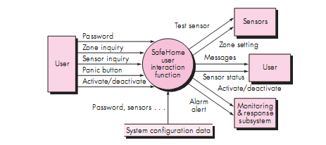
Function Point Example
The Interaction function in SafeHome manages user interaction, accepting a user password to activate or deactivate the system, and allows inquiries on the status of security zones and various security sensors.
The function displays a series of prompting messages and sends appropriate control signals to various components of the security system.
Three external inputs (EIs)—password, panic button, and activate/deactivate—are shown in the figure along with two external inquiries (EI)—zone inquiry and sensor inquiry. One ILF (system configuration file) is shown. Two external outputs (Eos) (messages and sensor status) and four EIFs (test sensor, zone setting, activate/deactivate, and alarm alert) are also present.

Slide 30
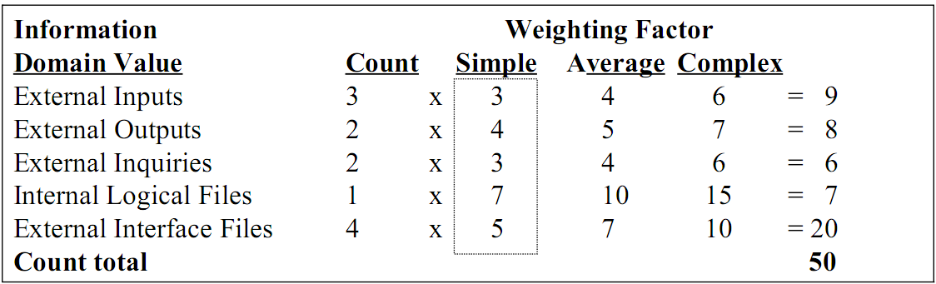
Function Point Example
FP = count total * [0.65 + 0.01 * sum(Fi)]
FP = 50 * [0.65 + (0.01 * 46)]
FP = 55.5 (rounded up to 56)

Slide 31
Function Point Example
The count total shown in last Figure must be adjusted .
For the purposes of this example, we assume that SumOf(F_{i}) is 46 (a moderately complex product).
Therefore, FP = 50 * [0.65 + (0.01 * 46)] = 56

Slide 32
Interpretation of the FP Number
Assume that past project data for a software development group indicates that
One FP translates into 60 lines of object-oriented source code
12 FPs are produced for each person-month of effort
An average of three errors per function point are found during analysis and design reviews
An average of four errors per function point are found during unit and integration testing
This data can help project managers revise their earlier estimates
This data can also help software engineers estimate the overall implementation size of their code and assess the completeness of their review and testing activities

Slide 33
Metrics for the Design Model

Slide 34
Metrics for the Design Model
Architectural metrics
Provide an indication of the quality of the architectural design
Component-level metrics
Measure the complexity of software components and other characteristics that have a bearing on quality
Interface design metrics
Focus primarily on usability
Specialized object-oriented design metrics
Measure characteristics of classes and their communication and collaboration characteristics

Slide 35
Architectural Design Metrics
These metrics place emphasis on the architectural structure and effectiveness of modules or components within the architecture
They are “black box” in that they do not require any knowledge of the inner workings of a particular software component

Slide 36
Hierarchical Architecture Metrics
Fan out: the number of modules immediately subordinate to the module i, that is, the number of modules directly invoked by module i.
Structural complexity
S (i) = f²_{out}(i), where f_{out}(i) is the “fan out” of module i
Data complexity
D(i) = v(i)/[f_{out}(i) + 1], where v(i) is the number of input and output variables that are passed to and from module i
System complexity
C(i) = S(i) + D(i)
As each of these complexity values increases, the overall architectural complexity of the system also increases
This leads to greater likelihood that the integration and testing effort will also increase

Slide 37
Hierarchical Architecture Metrics
Shape complexity
size = n + a, where n is the number of nodes and a is the number of arcs
Allows different program software architectures to be compared in a straightforward manner
Connectivity density (i.e., the arc-to-node ratio)
r = a/n
May provide a simple indication of the coupling in the software architecture

Slide 38
Metrics for Object-Oriented Design
Size
Population: a static count of all classes and methods
Volume: a dynamic count of all instantiated objects at a given time
Length: the depth of an inheritance tree
Coupling
The number of collaborations between classes or the number of methods called between objects
Cohesion
The cohesion of a class is the degree to which its set of properties is part of the problem or design domain
Primitiveness
The degree to which a method in a class is atomic (i.e., the method cannot be constructed out of a sequence of other methods provided by the class)

Slide 39
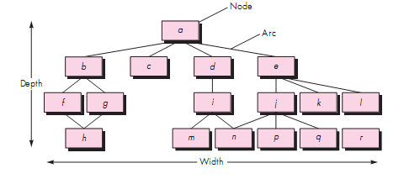
Hierarchical Architecture Metrics

Slide 40

Specific Class-oriented Metrics
Cyclomatic complexity is a source code complexity measurement that is being correlated to a number of coding errors.
It is calculated by developing a Control Flow Graph of the code that measures the number of linearly-independent paths through a program module.
Lower the Program's cyclomatic complexity, lower the risk to modify and easier to understand. It can be represented using the below formula:
Normalized Complexity of each method = (Complexity of method –
Minimum Complexity in class)/ (Maximum Complexity– Minimum Complexity)

Slide 41
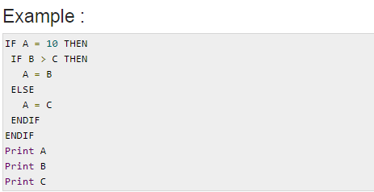
Example to determine Cyclomatic Complexity

Slide 42
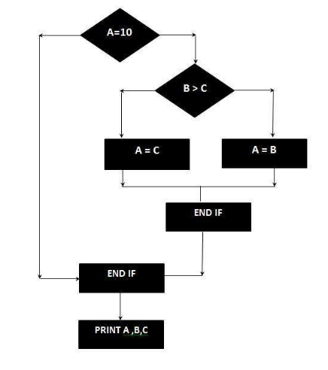
Control flow graph
No. of nodes = 7
No. of edges = 8
No. of exit points = 1
Cyclomatic Complexity = 8 – 7 + 2 *1
= 3

Slide 43
Specific Class-oriented Metrics
Weighted methods per class
The normalized complexity of the methods in a class
Indicates the amount of effort to implement and test a class
Depth of the inheritance tree
The maximum length from the derived class (the node) to the base class (the root)
Indicates the potential difficulties when attempting to predict the behavior of a class because of the number of inherited methods
Number of children (i.e., subclasses)
As the number of children of a class grows
Reuse increases
The abstraction represented by the parent class can be diluted by inappropriate children
The amount of testing required will increase

Slide 44
Specific Class-oriented Metrics
Coupling between object classes
Measures the number of collaborations a class has with any other classes
Higher coupling decreases the reusability of a class
Higher coupling complicates modifications and testing
Coupling should be kept as low as possible
Response for a class
This is the set of methods that can potentially be executed in a class in response to a public method call from outside the class
As the response value increases, the effort required for testing also increases as does the overall design complexity of the class
Lack of cohesion in methods
This measures the number of methods that access one or more of the same instance variables (i.e., attributes) of a class
If no methods access the same attribute, then the measure is zero
As the measure increases, methods become more coupled to one another via attributes, thereby increasing the complexity of the class design

Slide 45
Metrics for Maintenance

Slide 46
Metrics for Maintenance
Software maturity index (SMI)
Provides an indication of the stability of a software product based on changes that occur for each release
SMI = [MT - (Fa + Fc + Fd)]/MT
where
MT = #modules in the current release
Fa = #modules in the current release that have been added
Fc = #modules in the current release that have been changed
Fd = #modules from the preceding release that were deleted in the current release
As the SMI (i.e., the fraction) approaches 1.0, the software product begins to stabilize
The average time to produce a release of a software product can be correlated with the SMI

